Slide 1

Hanging around
A look book and exploration by Xochitl de la Torre

Slide 2
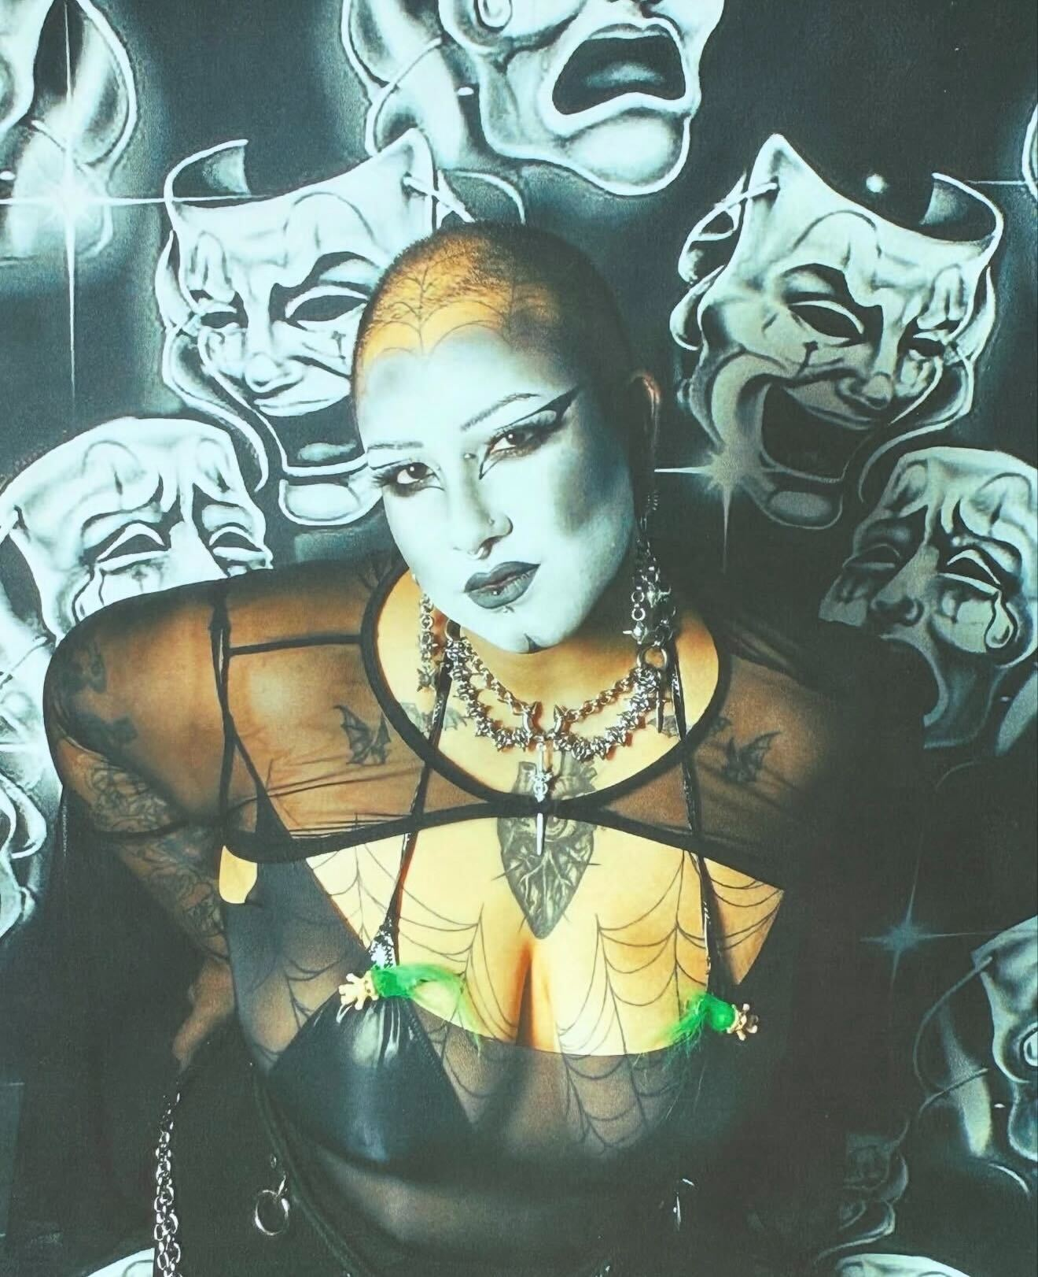

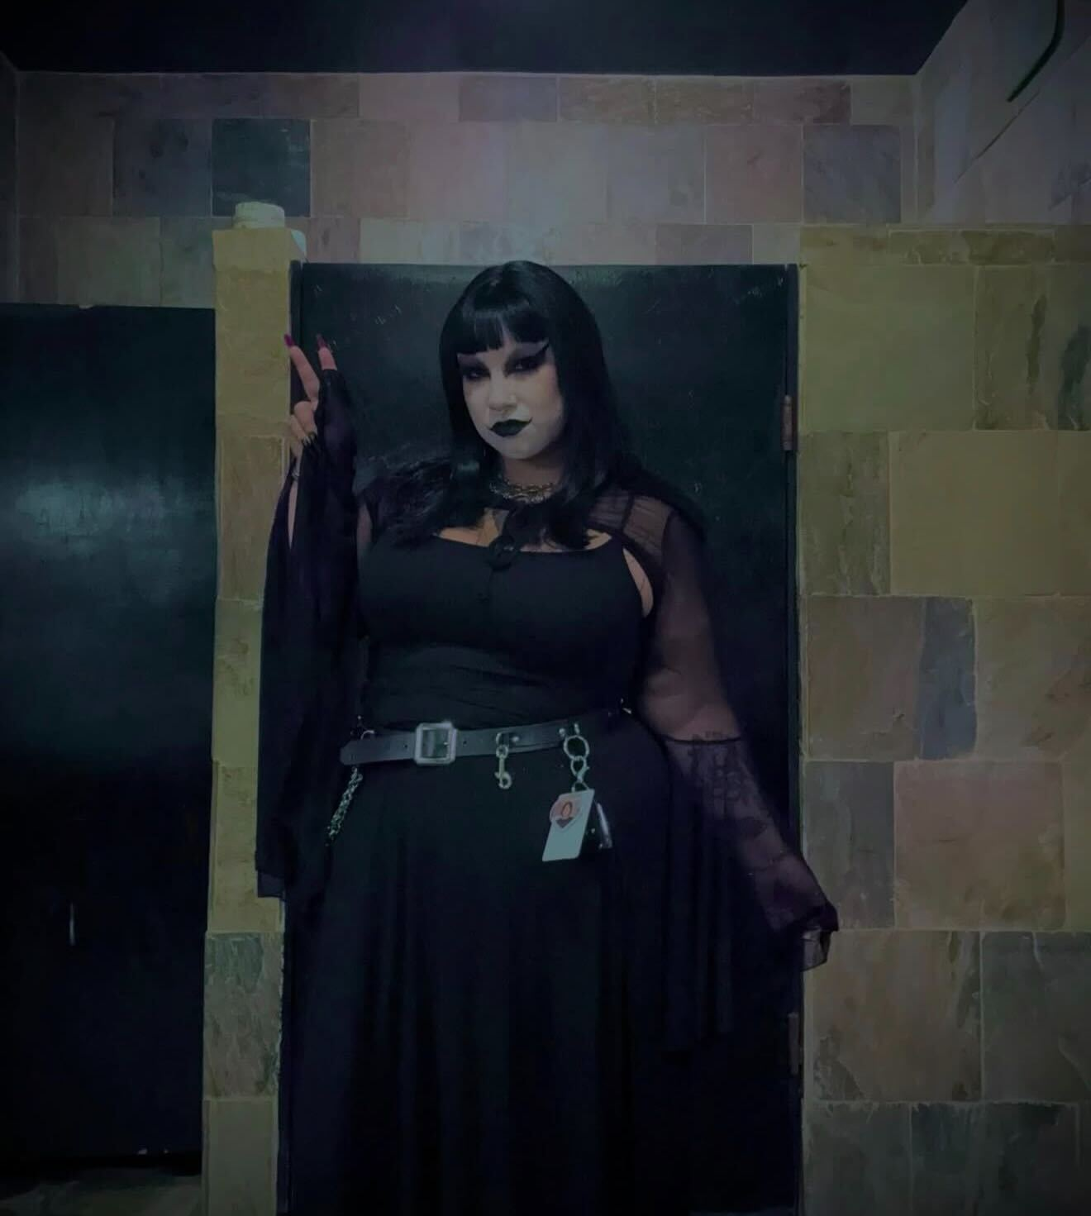
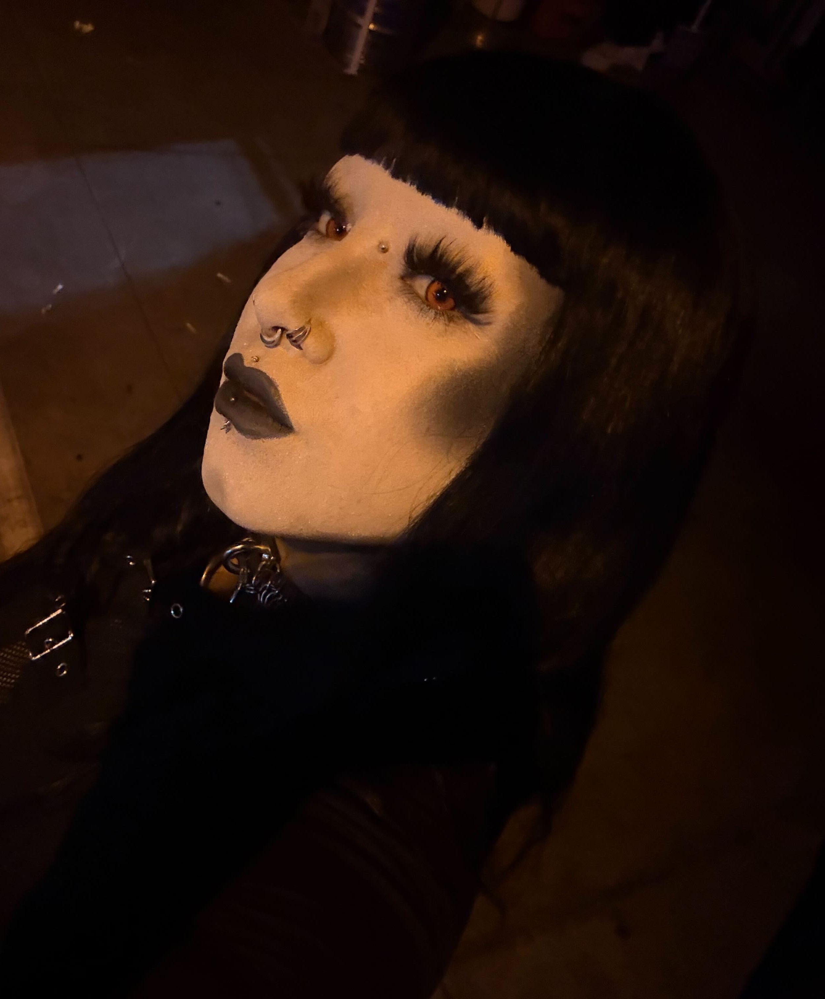
White face paint for dark nights
White face paint serves as a foundational element of the goth aesthetic, creating a stark, ethereal canvas that defies conventional beauty standards. This high-contrast look emphasizes dramatic features, effectively distancing the wearer from mainstream trends and embracing a somber, melancholic elegance. Beyond its visual impact, it acts as a stylistic bridge to the subculture's roots in classic horror and post-punk, cementing a distinct, spectral identity.

Slide 3
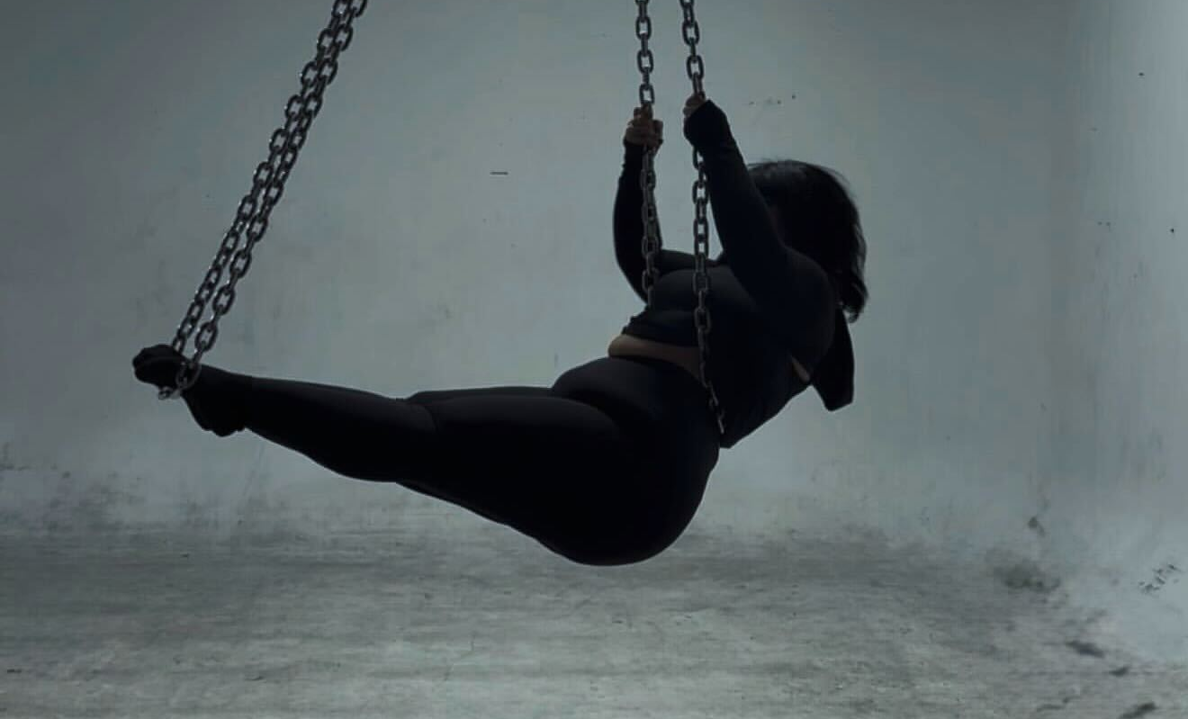
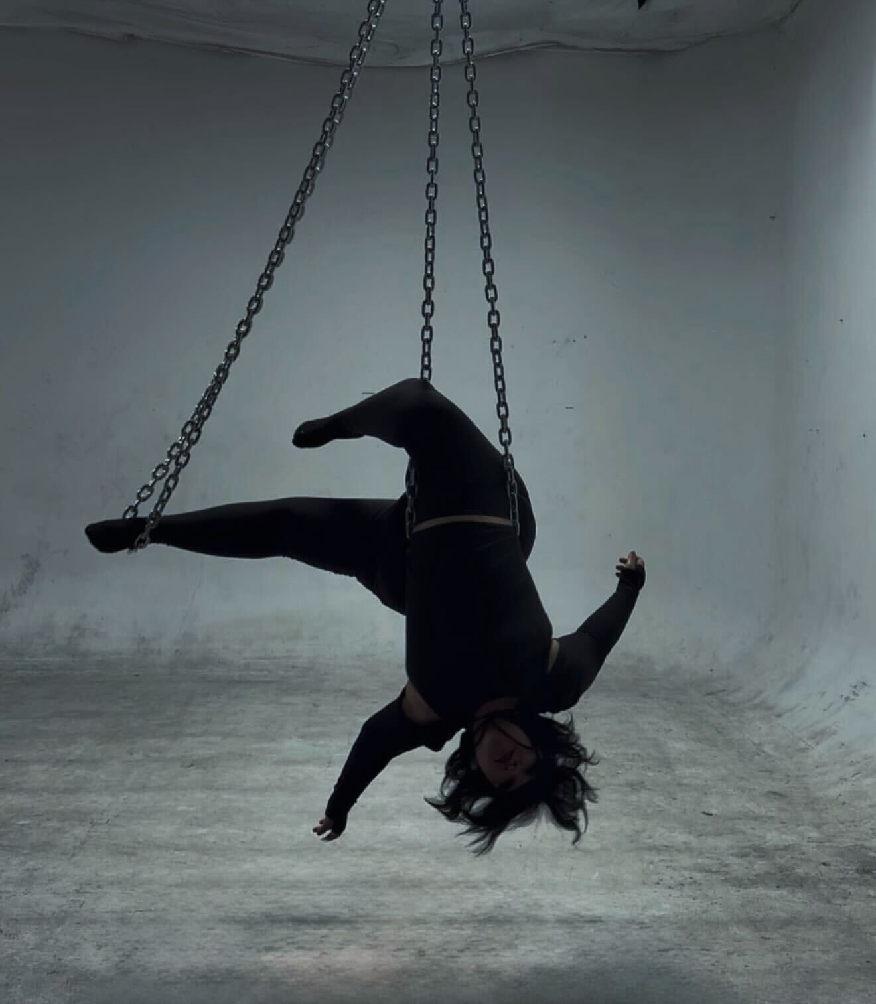
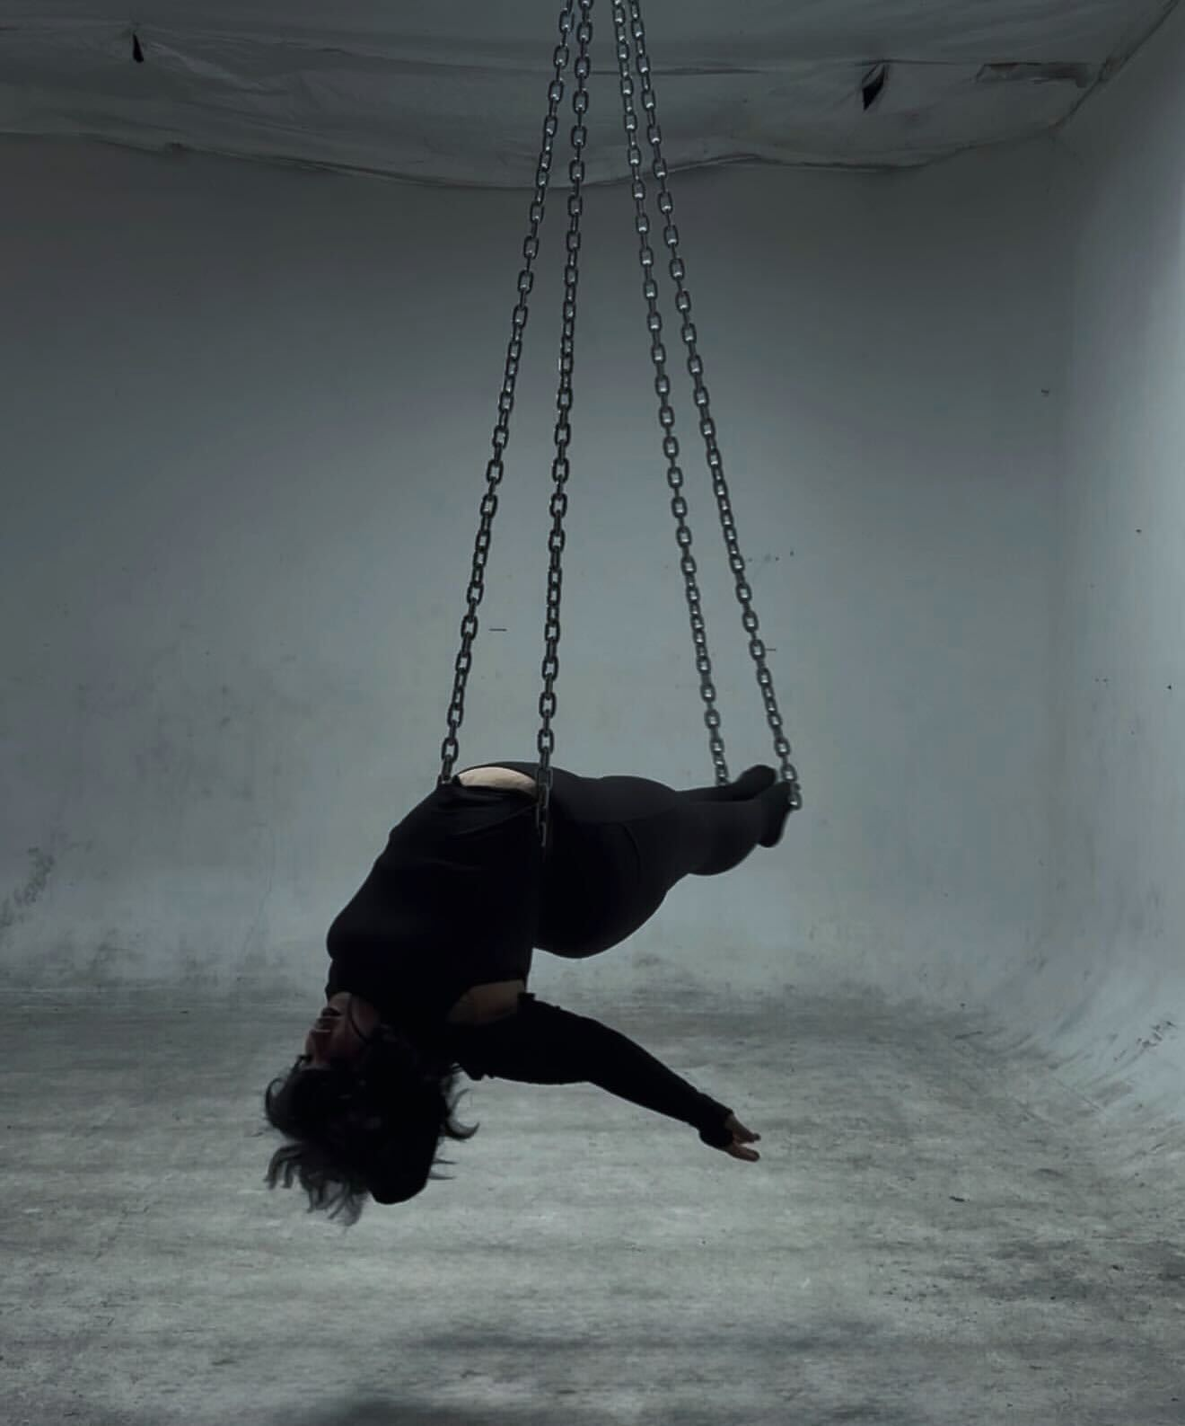
The Industrial Elegance of Aerial Chains
Aerial chains transform a traditional circus art into a raw, industrial performance that mirrors the somber and metallic undertones of the goth subculture. The cold, heavy texture of the steel provides a stark, visceral contrast to the artist’s fluid movement, evoking a sense of "beautiful pain" common in gothic expression. This discipline allows for a unique fusion of physical strength and dark theatricality, turning a gravity-defying act into a hauntingly monochromatic display of shadows and iron.

Slide 4
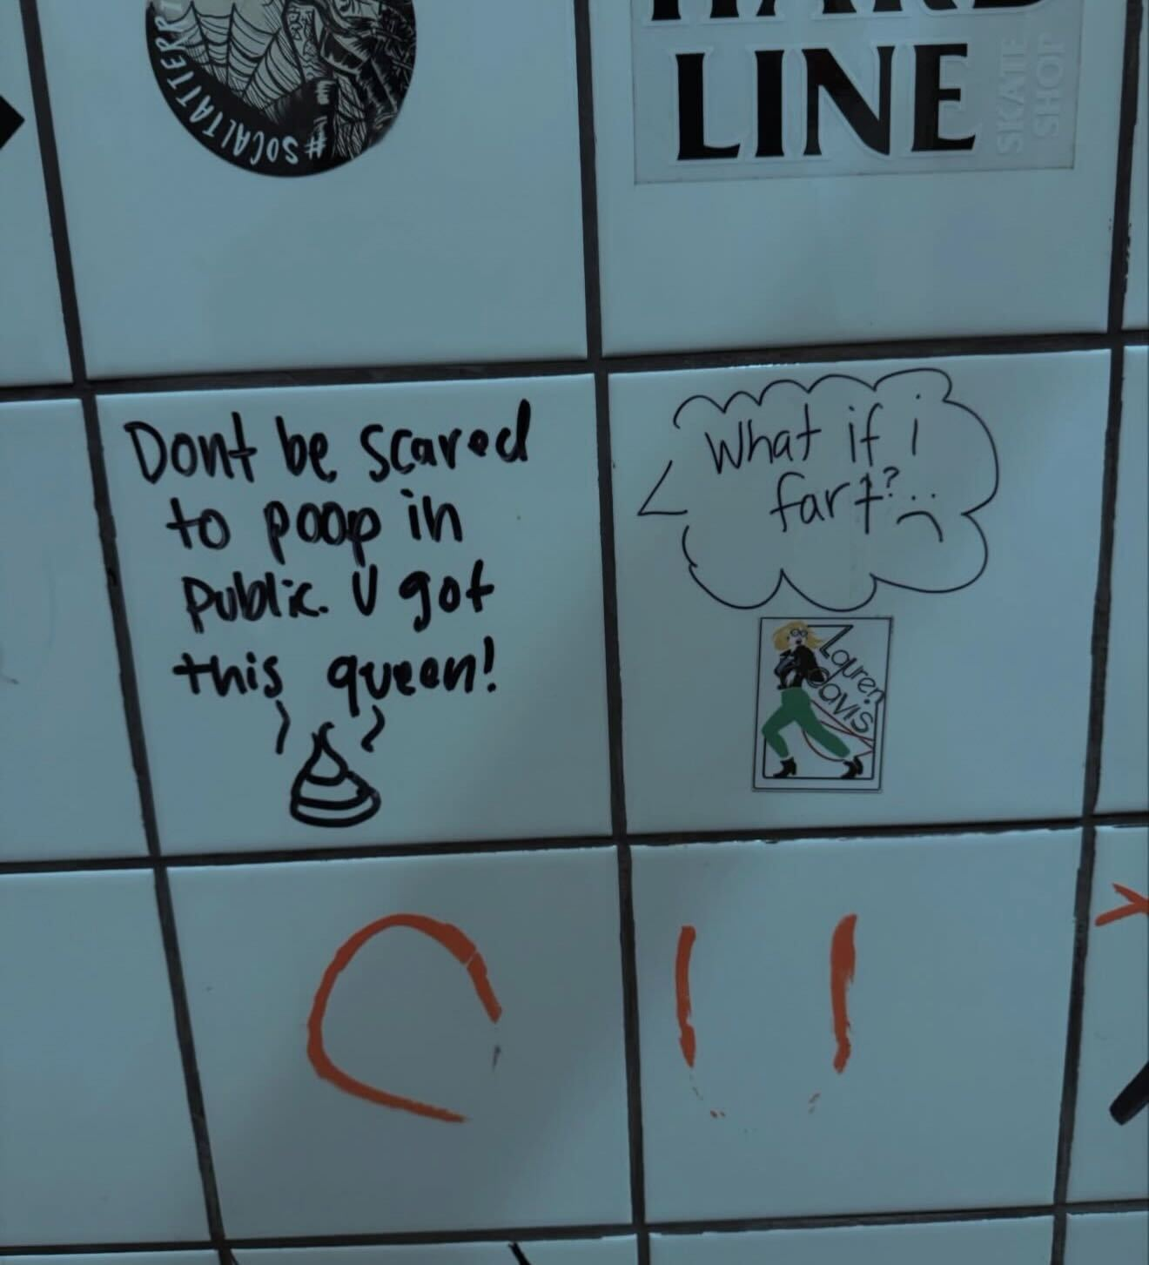
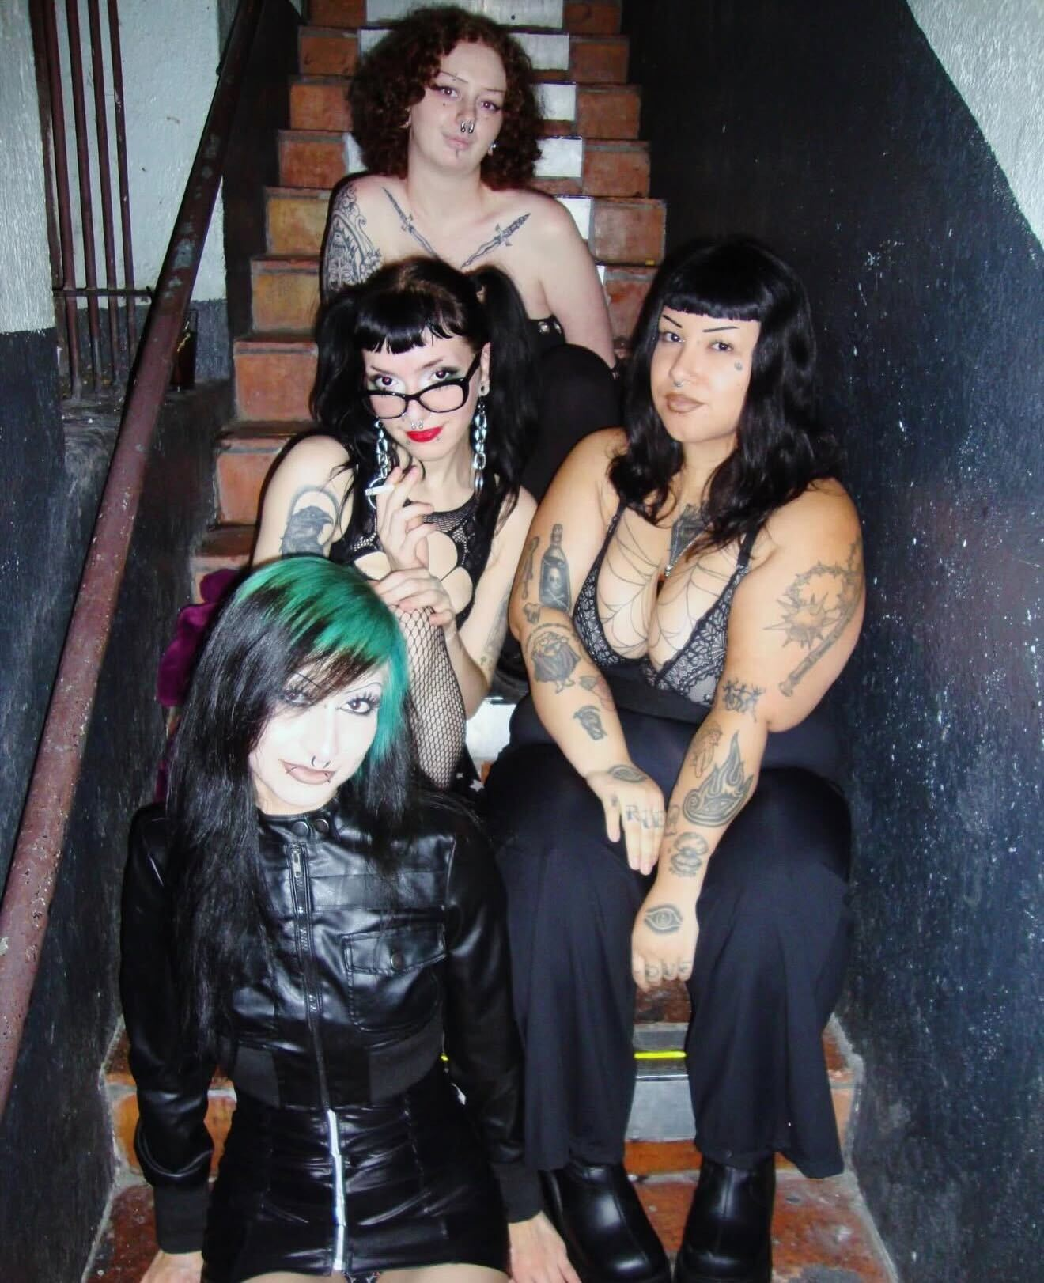
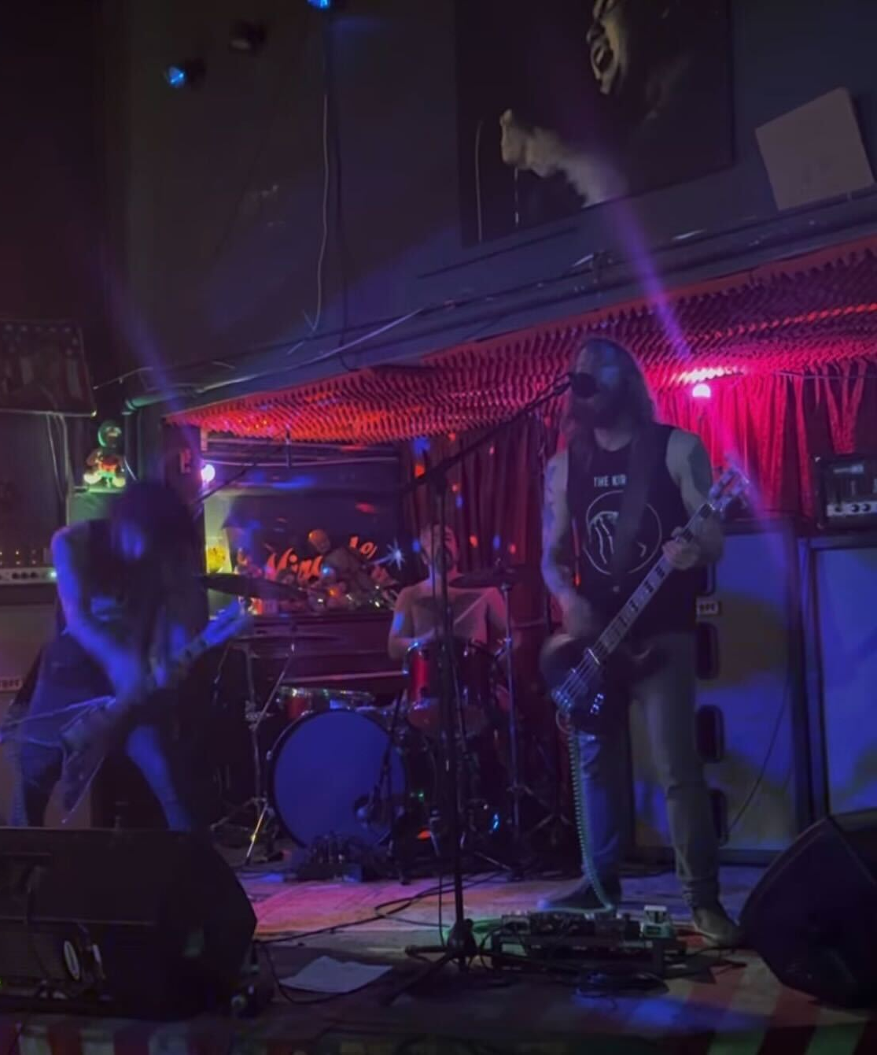

The Architecture of After-Hours
These spaces are the visceral, neon-lit extensions of our stage, where the heavy aesthetics of the night find their true rhythm. Beyond the dance floor, they serve as essential sanctuaries for community, grounding our shared identity in the grit and shadows of our favorite haunts. Here, the boundary between performance and life blurs, transforming every drink and conversation into a necessary ritual of the scene.

