Slide 1
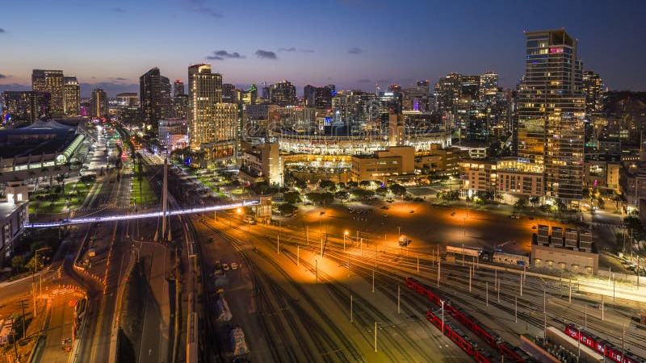
The freaks come out at night
Goth Nights in Southern California
Xochitl de la Torre

Slide 2
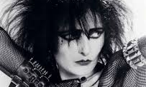
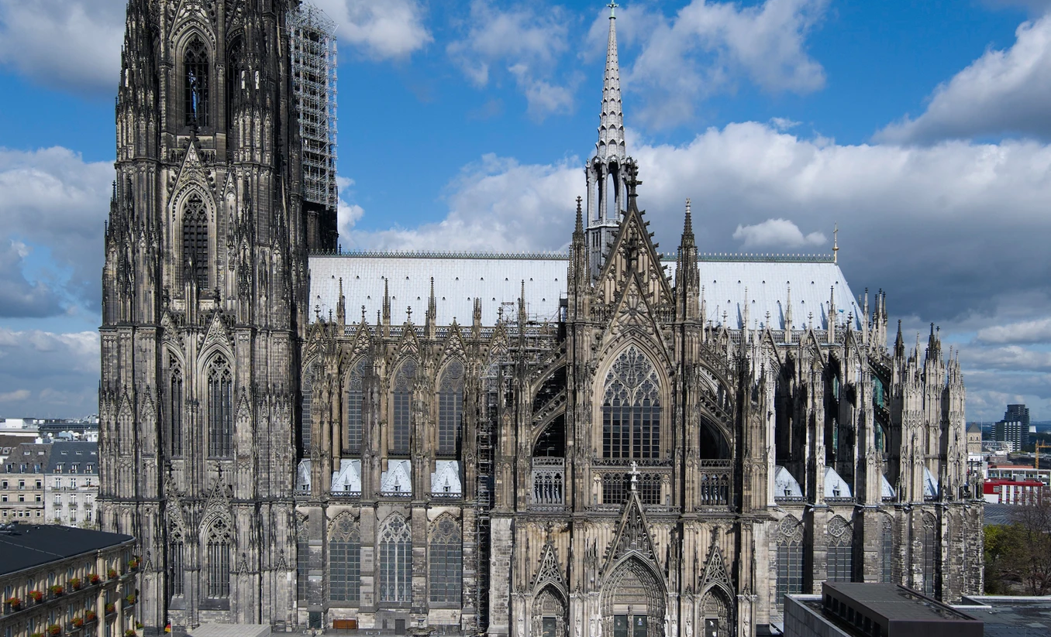
What is "Goth"?
A Music-First Subculture
Started as a music movement in the late 1970s and early 1980s. It branched off from the UK Punk scene when bands started moving away from fast, aggressive sounds toward more atmospheric, "dark" post-punk music
The "Dark" Romantic Aesthetic
Draws heavily on 18th-century Gothic literature (think Dracula or Mary Shelley’s Frankenstein) and German Expressionist films. This is why you see so much velvet, lace, and dramatic makeup—it’s an appreciation of the "beautiful macabre."
The Power of DIY (Do-It-Yourself)
Goths have historically made their own clothes, bleached their own hair, and customized their gear. This makes the subculture highly creative and individualistic.
Community and Inclusivity
A community that values artistic expression, emotional depth, and non-conformity, providing a space where people can express themselves without being judged by mainstream standards.

Slide 3
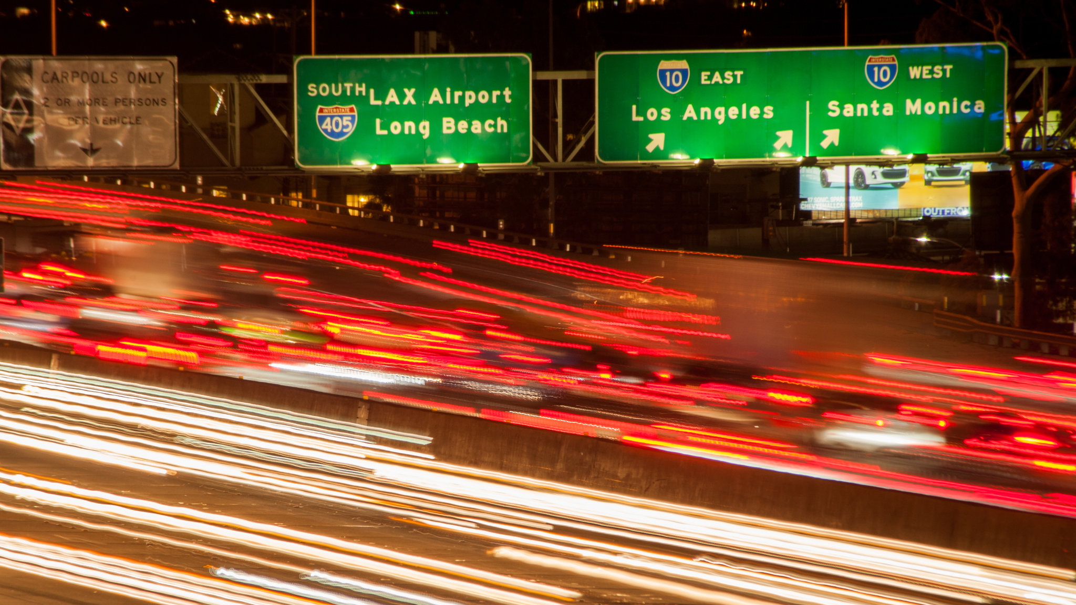
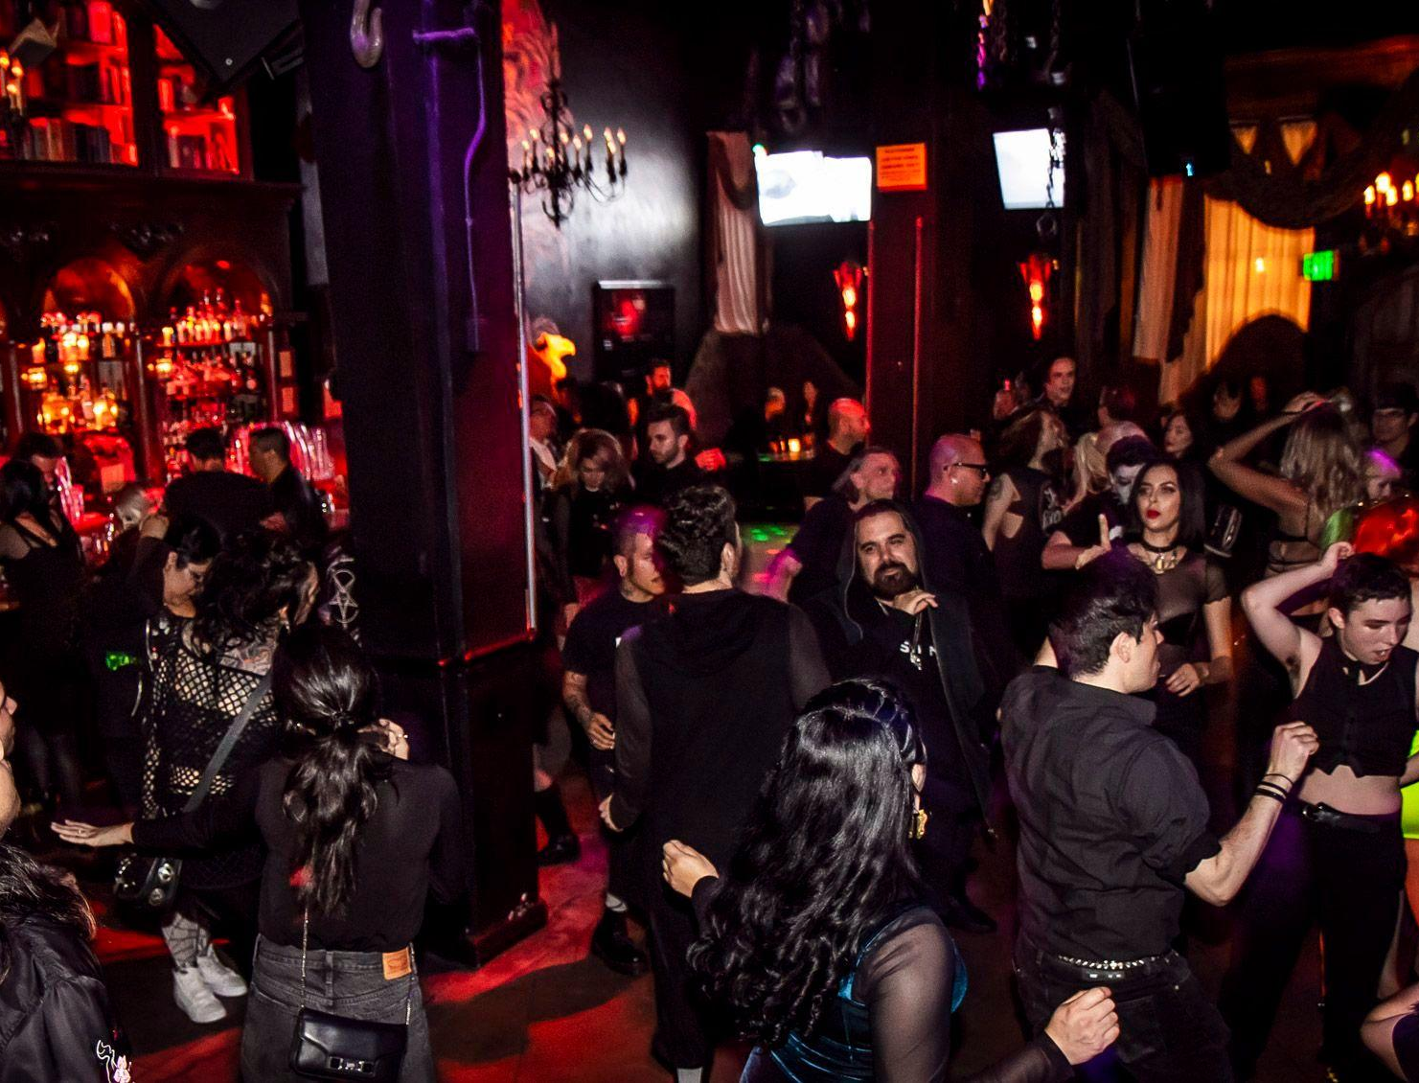
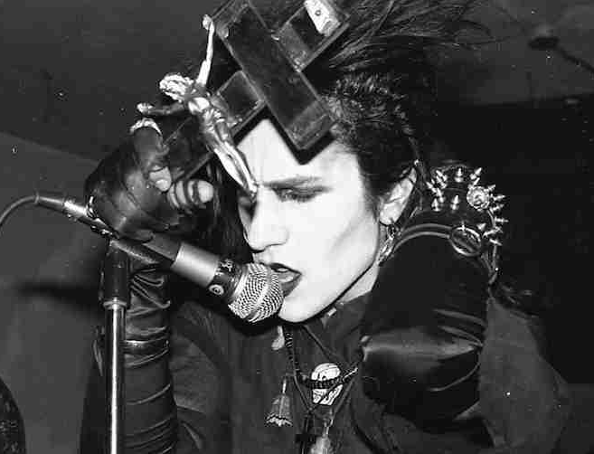
SoCal: The Dark Heartland
The Epicenter: Southern California is a global hub for the alternative scene.
Historical Influence: Home to "Deathrock" pioneers like Christian Death and 45 Grave.
365 Days of Darkness: Unlike other cities, SoCal has enough clubs to go out every single night.

Slide 4
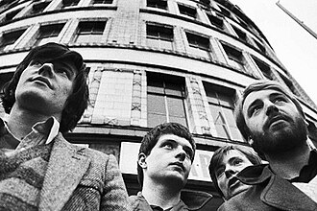
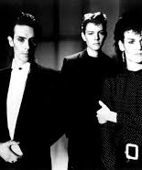
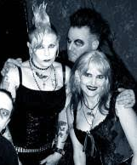

The Sound
Genre Breakdown: Post-Punk, Darkwave, Goth Rock, and Industrial.
Core Instruments: Heavy basslines, "chorus" guitar effects, and atmospheric synths.
Modern Revival: A new wave of SoCal bands is keeping the sound alive today.

Slide 5
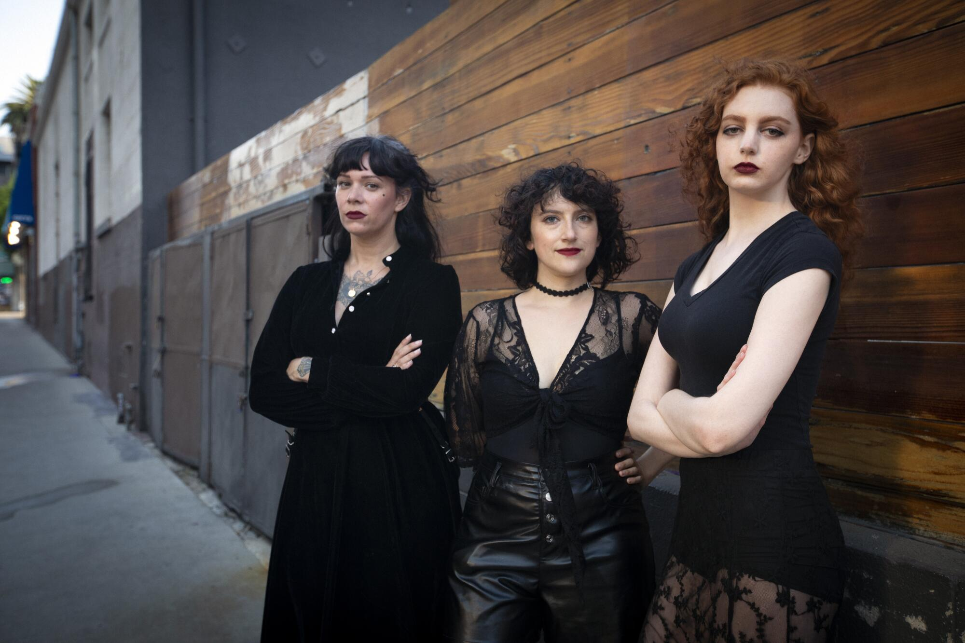
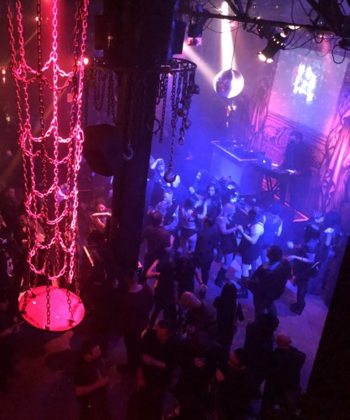
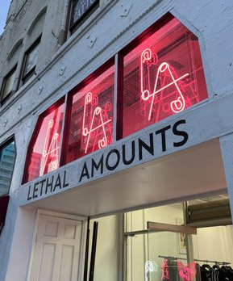
Iconic Venues: Los Angeles
Bar Sinister: The legendary Hollywood spot at Boardner’s (Saturdays).
The Cloak & Dagger: Known for its "secret society" vibes and strict dress codes.
Lethal Amounts: A gallery/space focusing on the gritty history of the scene.

Slide 6
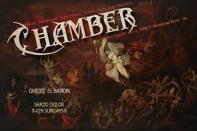
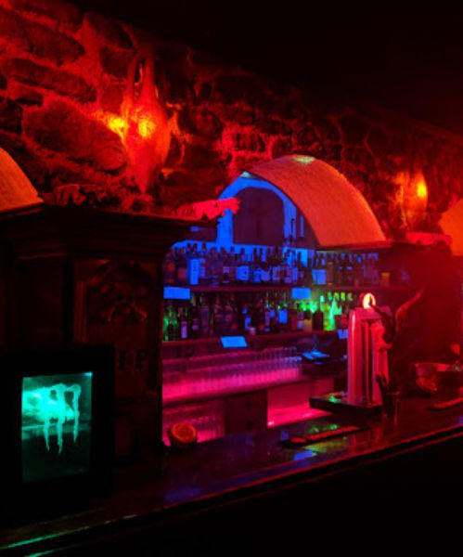
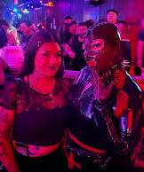
Iconic Venues: OC & San Diego
The Chamber (Anaheim): A staple for Orange County goths for decades.
Club Undead (Whittier): Known for its "Old School" 80s goth vibes.
Sabbat (San Diego): Proving the dark scene thrives south of the 405.

Slide 7
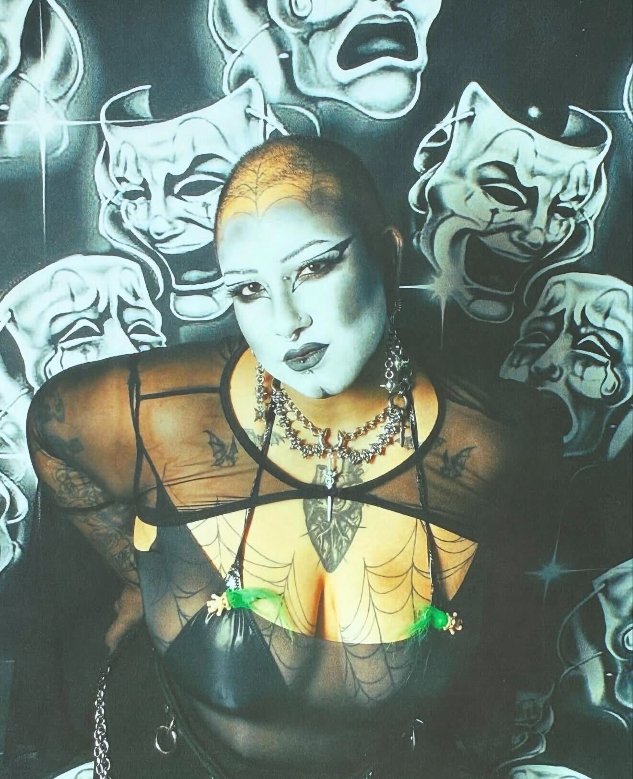
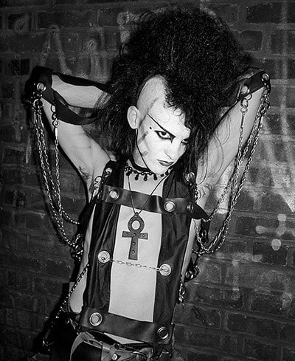
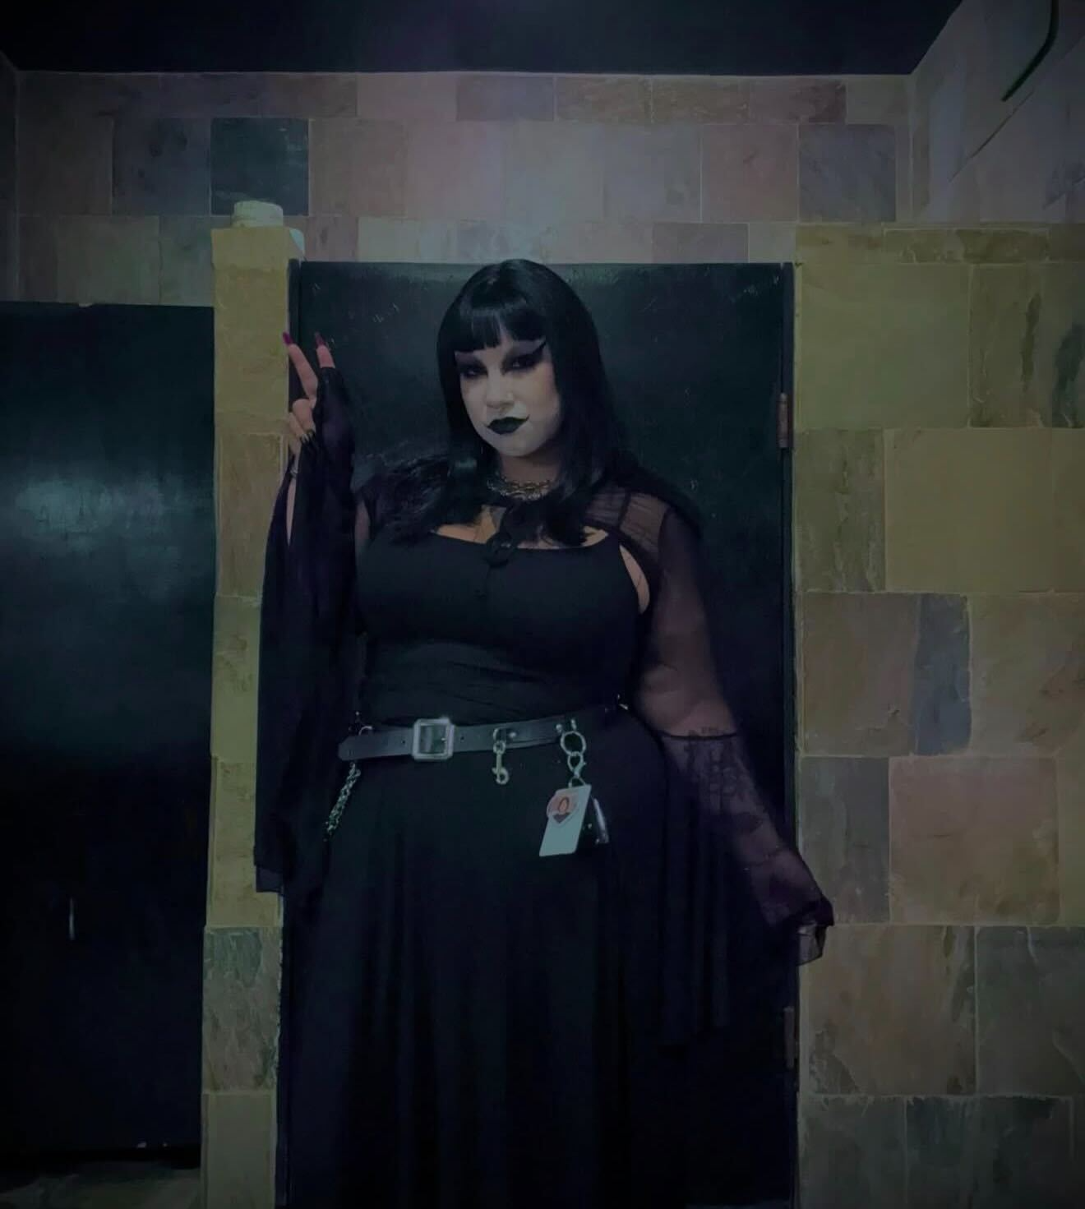
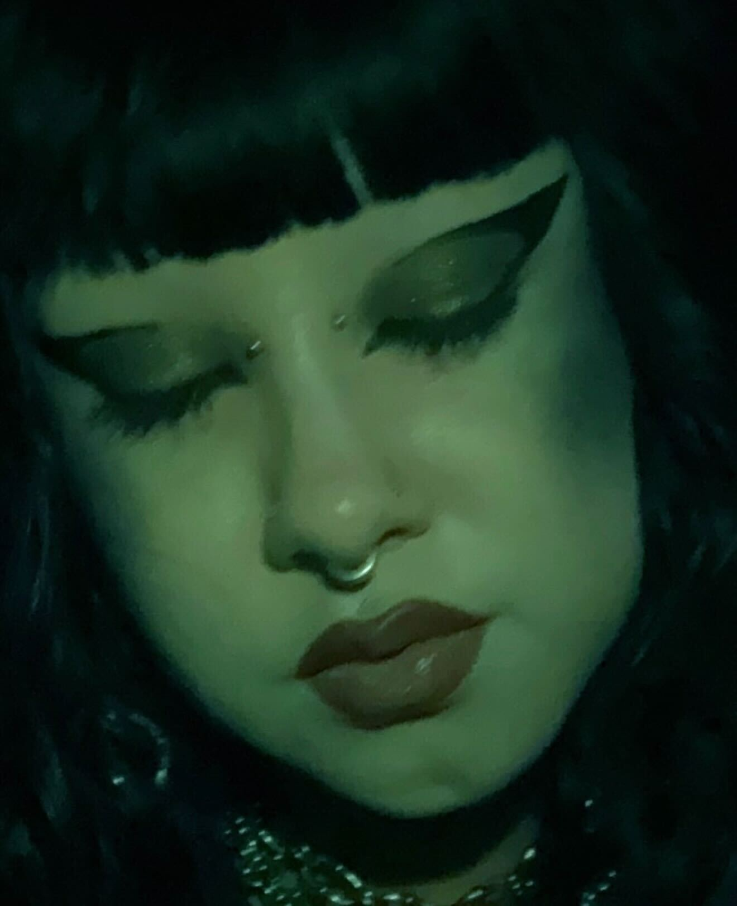
"The Ritual": Getting Ready
The Transformation: Getting ready is part of the art form.
The Makeup Kit: Heavy contouring, "trad-goth" brows, and white foundation.
Hair as Sculpture: Teasing, "death-hawks," and extreme hairspray usage.

Slide 8
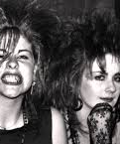
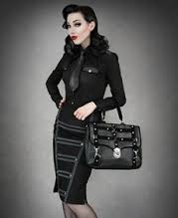
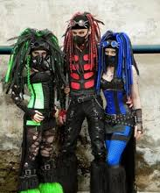
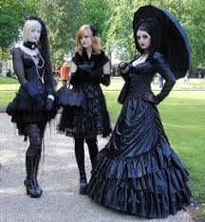
Fashion Subsets
Trad Goth: 80s inspired—fishnets, leather, and teased hair.
Cyber Goth: Neon colors, gas masks, and industrial "cybergoth" hair extensions.
Victorian Goth: High-fashion mourning wear, corsets, and top hats.
Corporate Goth: Bringing the aesthetic into the 9-to-5 workspace.

Slide 9
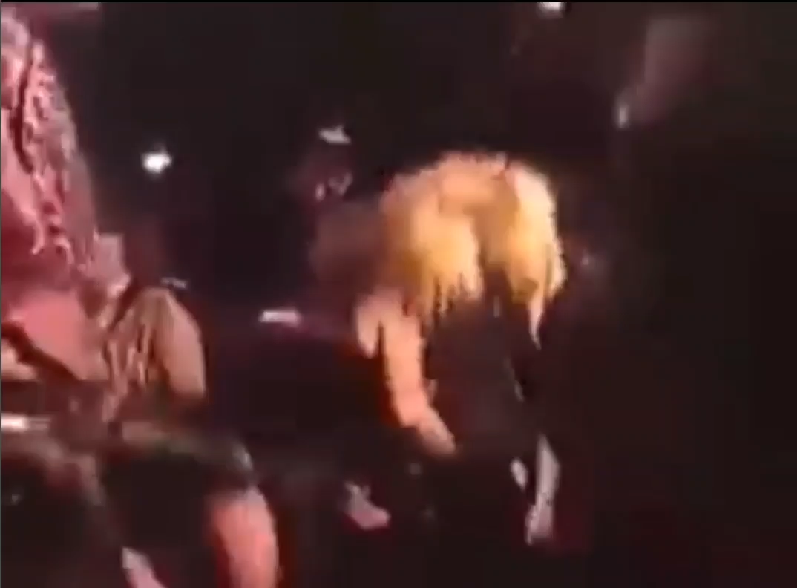
The Experience: On the Dancefloor
The "Goth Two-Step": A subtle, rhythmic side-to-side movement.
The Atmosphere: Fog machines and strobe lights are essential.
Safe Space: The dancefloor is a place of expression, not judgment.

Slide 10
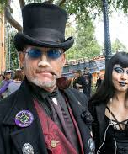
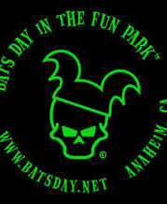
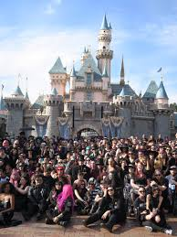
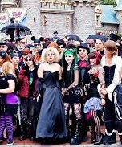
Beyond the Club: Bats Day at Disneyland
Contrast: Thousands of Goths gathering at the "Happiest Place on Earth."
Annual Event: An unofficial day where the community takes over the park.
The "Goth Social": Proves that the scene is family-friendly and community-oriented.

Slide 11
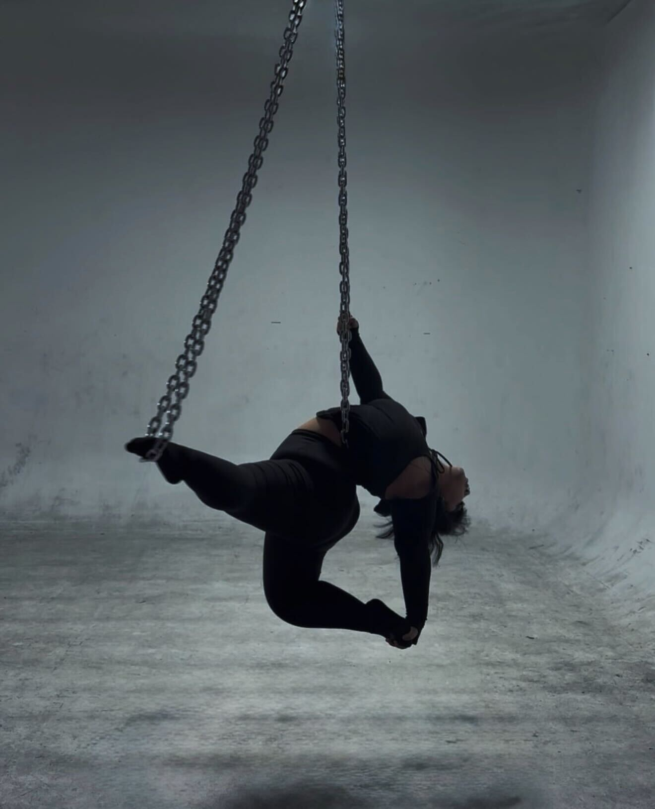
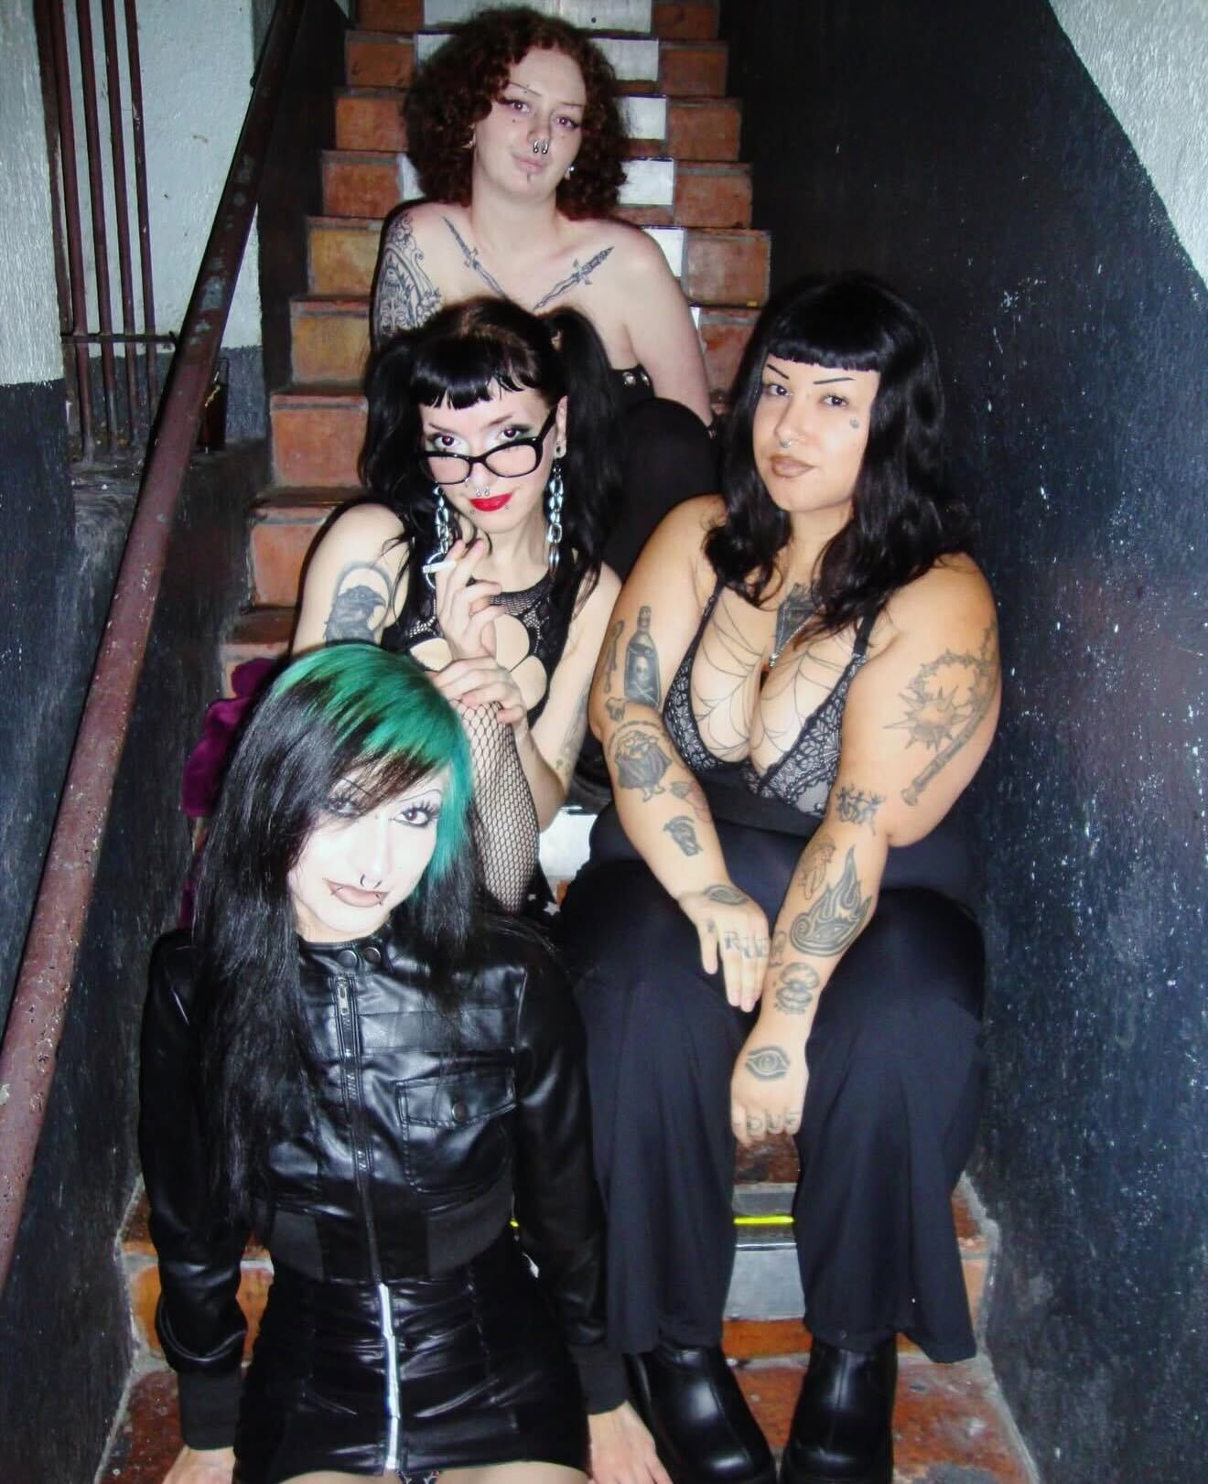
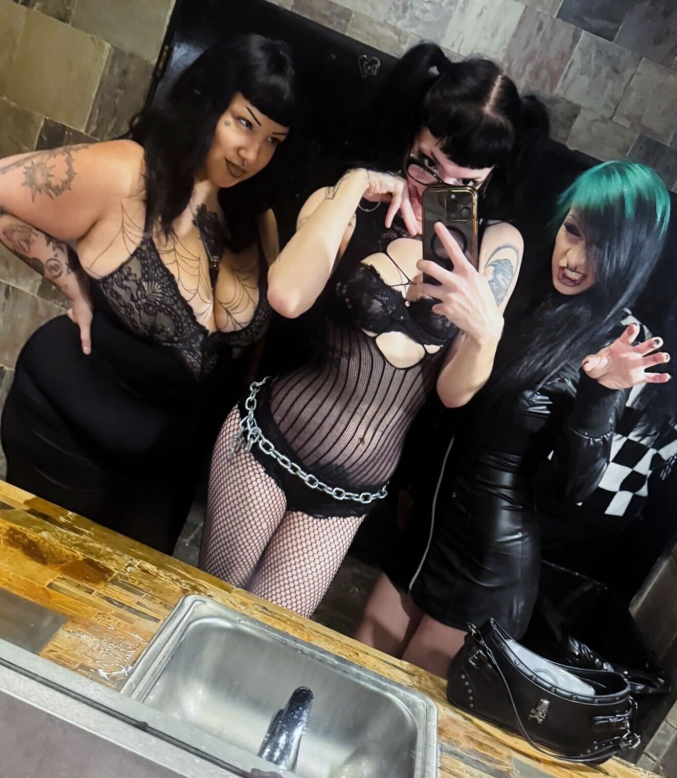
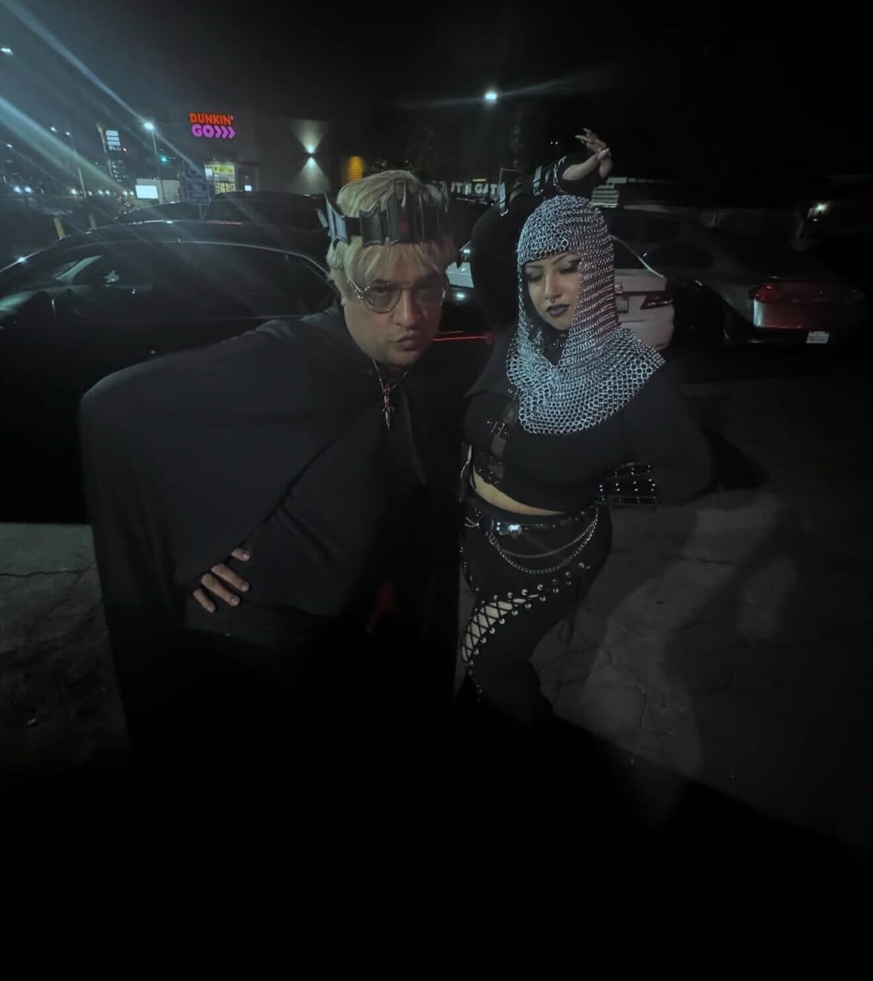
Release the Bats (Why I Go Out)
Finding Community: Connecting with people who share a niche interest.
Creative Outlet: Using fashion and dance as a form of "living art."
Mental Health: A supportive space for those who feel like outsiders.

Slide 12
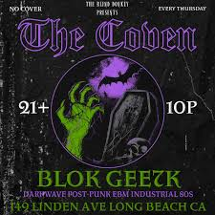
Finding Your Own Night
Restless Nites: The go-to app for underground event listings in LA.
Social Media: Following specific DJs and promoters (DJ Blok and DJ GEE7K).
Invitation: The scene is always welcoming to those who respect the music.

Slide 13
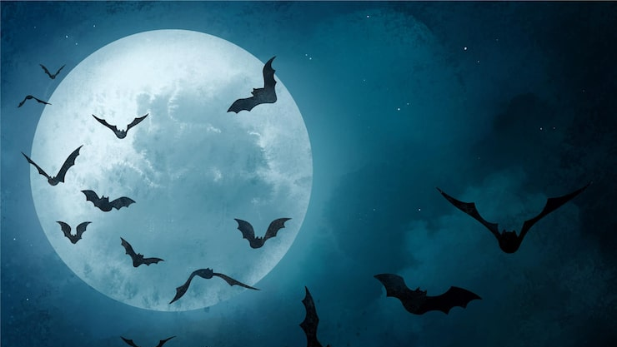
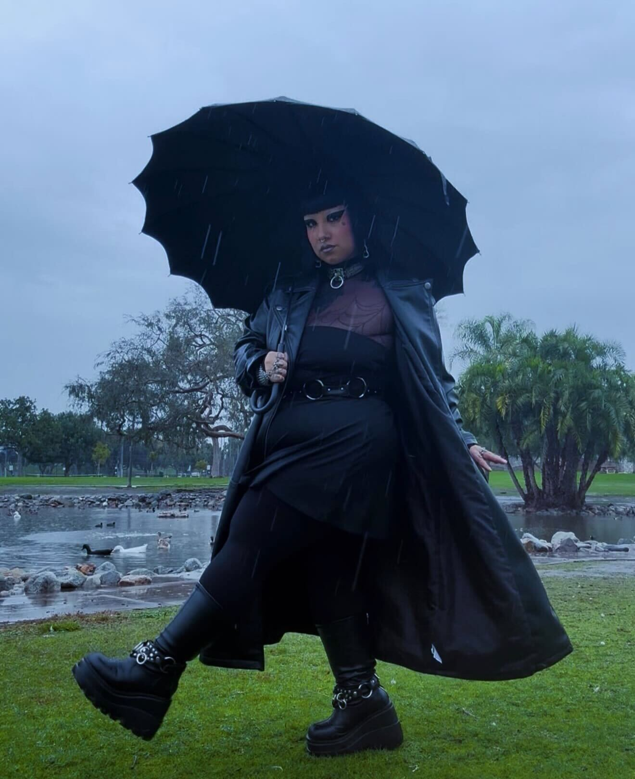
Conclusion & Q&A
Bela Lugosi's Dead, but the scene is very much alive.
Summary: Goth is about more than just clothes; it's a rich SoCal legacy.
Any Questions?

